Slide 1
Room Automation

Slide 2
Team Members
Mentor
Manav Saraf
Ritesh Kumar Gupta
Shubh Balodi
Mohit
Saurabh Singh

Slide 3
Content
01
02
Introduction
Equipment required
03
04
Development phases
Working and Guide

Slide 4
“Home is where the comfort is. The real comfort lies in living smart and simple”

Slide 5
01
Introduction

Slide 6
Aim
Control of the electrical appliances through smartphones and switches simultaneously using a nodeMCU module.
Developing an end-to-end solution that can be controlled through a full-fledged React Web App with proper authentication and integrated voice command.

Slide 7
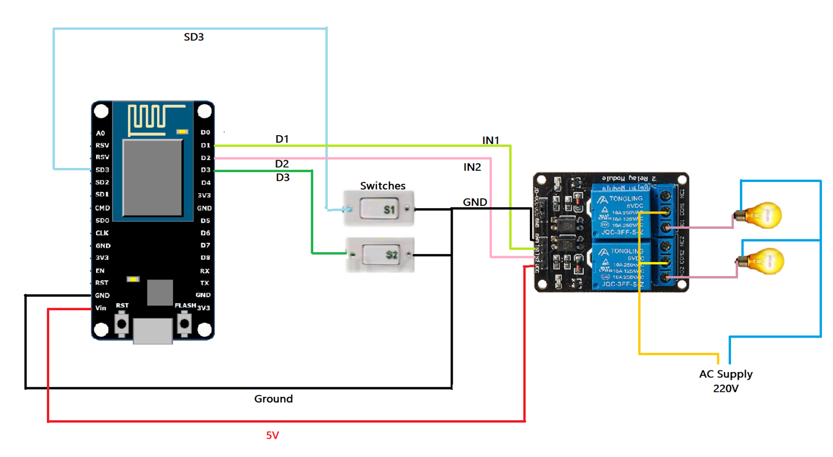
Equipment Used &Circuit Diagram
Tactile Switches
Node MCU
Connecting wires
Relay
Bread board

Slide 8
Development phases
1
Checking the functionality of the circuit designed using Blynk app
Made a basic bread board circuit and checked its functionality using switches.
Used Blynk app to control the appliance using wireless means.
Integrated the functionality of Blynk app with the tactile switches to control the appliance by manual switching and through Wi-Fi parallelly.

Slide 9
Development phases
2
Creating live voltage equivalent of the designed circuit
Powered the circuit directly from the power supply.
Replaced devices with 220V rated equipment like light bulbs and relay switches.
Used Google Home App to connect the devices to be controlled.

Slide 10
Development phases
3
Creating a website for user interaction
Designed a website using React framework with authentication to remove the necessity of google home.
Fetching the data from Sinric Pro through API calls.
Checking the online availability of the devices and changing its state while maintaining the functionality of the tactile switches.

Slide 11
Working Guide
Download and setup code base locally on your device.
Register yourself on Sinric Pro portal and obtain App secret, App Key, Device IDs.
Add the App secret, App Key, Device IDs and Wi-Fi credentials in the Node MCU code.
Upload the code onto the Node MCU module.
Login on the project website with the same credentials.
Add and control your devices from the interface provided on the dashboard of our website.

Slide 12
Login on our portal
Check and modify online state of the devices
Sync with Manual control option
Go to Dashboard

Slide 13
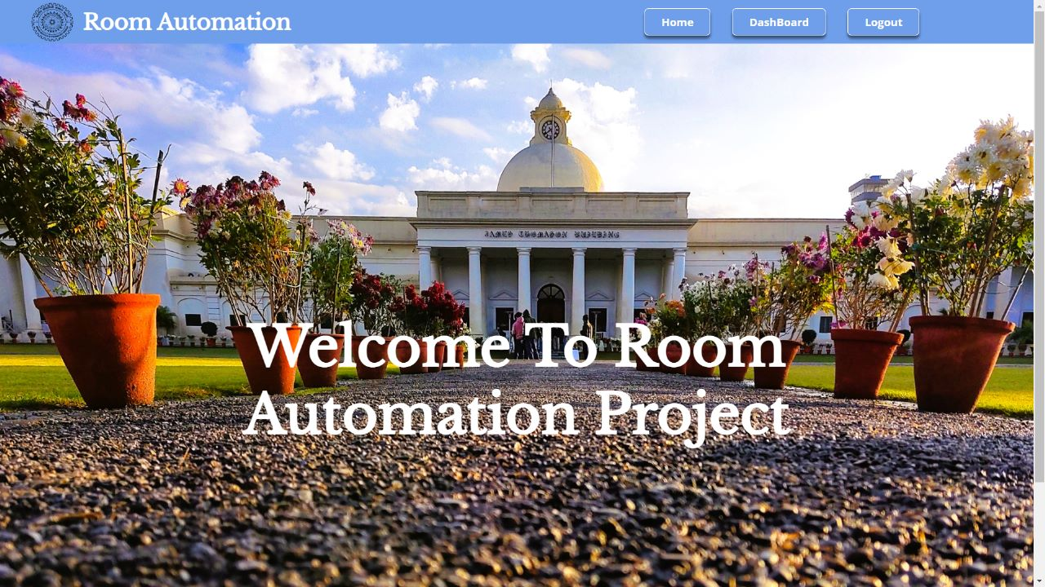
OUR WEBSITE

Slide 14

Future Plans
Alan Integration to the Website via React.

